Slide 1

CMP301B/CMPN301: Computer Architecture
Pipelining Hazards - Sheets 2 & 3
Maheed Hatem
Computer Engineering Department
Cairo University
Spring 2020

Slide 2
Agenda
Review on Hazards
Review on Structural Hazards
Review on Data Hazards
Review on Control Hazards
Sheet 2: Problem 2
Sheet 3

Slide 3
Structural Hazards
Structural Hazards occur when two instructions require using the same hardware in the same cycle
Example 1: Using the register for reading (in decode stage) and writing (in write-back stage).
Ensure writing is done in the first half cycle and reading is done in the second half cycle.
 | 1 | 2 | 3 | 4 | 5 | 6 | 7 | 8
ADD R1, R0, R2 | F | D | E | M | W
Instr |  | F | D | E | M | W
Instr |  |  | F | D | E | M | W
SUB R2, R1, R5 |  |  |  | F | D | E | M | W

Slide 4
Structural Hazards
Example 2: Using the memory for fetching instruction (in fetch stage) and data access (in memory stage).
Stall the fetched instruction
Use two separate caches one for instructions and one for the data.
 | 1 | 2 | 3 | 4 | 5 | 6 | 7 | 8 | 9
LW R1,2(R2) | F | D | E | M | W
Instr |  | F | D | E | M | W
Instr |  |  | F | D | E | M | W
Instr |  |  |  | bubble | F | D | E | M | W

Slide 5
Data Hazards
ADD R1, R2, R3
BEQ R1,R4,Label
Data dependency can be divided into
RAW (Read after write)
WAR (Write after read)
WAW (Write after write)
In in-order execution we do not face hazards because of WAR and WAW dependencies. We only care about RAW dependencies.
We will discuss WAR and WAW when we reach out of order execution.
ADD R1, R2, R3
SUB R2, R4, R5
ADD R1, R2, R3
SUB R1, R4, R5

Slide 6
Data Hazards - Continued
 | 1 | 2 | 3 | 4 | 5 | 6 | 7 | 8
ADD R1, R2, R3 | F | D | E | M | W
ADD R4, R1, R2 |  | F | D | D | D | E | M | W

Slide 7
Data Hazards - Continued
There are software solutions by reordering the code.
We can stall the pipeline to resolve data hazards but this is not efficient.
With full forwarding data is forwarded to ALU from ALU and memory.
This means that we can access data that has been output in the previous cycle from execute stage or memory stage.
With ALU-ALU forwarding data is only forwarded form ALU.
This means that we cannot access data that has been output in the previous cycle from memory stage.
We can only access data output from execute stage.
We will stall if data is in memory.

Slide 8
Data Hazards - Continued
Full Forwarding Example:
 | 1 | 2 | 3 | 4 | 5 | 6 | 7 | 8
ADD R1, R2, R3 | F | D | E | M | W
ADD R4, R1, R2 |  | F | D | E | M | W
BEQ R1, R4, Label (NT) |  |  | F | D | E | M | W
SUB R5, R1, R3 |  |  |  | F | D | E | M | W

Slide 9
Data Hazards - Continued
ALU-ALU Forwarding Example:
 | 1 | 2 | 3 | 4 | 5 | 6 | 7 | 8 | 9 | 10
ADD R1, R2, R3 | F | D | E | M | W
ADD R4, R1, R2 |  | F | D | E | M | W
BEQ R1, R4, Label (NT) |  |  | F | D | D | D | E | M | W
SUB R5, R1, R3 |  |  |  | F | F | F | D | E | M | W

Slide 10
Data Hazards - Continued
Load-use scenario is when RAW dependency depends on a load instruction.
If the required data is output from the memory stage we have to wait to the memory stage to output the data.
We will always stall in load-use case.

Slide 11
Data Hazards - Continued
Load-Use Example:
 | 1 | 2 | 3 | 4 | 5 | 6 | 7 | 8
LW R1, 0(R2) | F | D | E | M | W
ADD R4, R1, R2 |  | F | D | D | E | M | W
BEQ R1, R4, Label (NT) |  |  | F | F | D | E | M | W

Slide 12
Control Hazards
From the lecture’s slide: An occurrence in which the proper instruction cannot execute in the proper clock cycle because the instruction that was fetched is not the one that is needed; that is, the flow of instruction addresses is not what the pipeline expected.

Slide 13
Control Hazards - Continued
Control Hazard Example:
 | 1 | 2 | 3 | 4 | 5 | 6 | 7 | 8
BEQ R1, R4, Label (T) | F | D | E | M | W
Instr2 |  | F | D
Instr3 |  |  | F
Instr4
….
Label: Sub R1, R2, R3 |  |  |  | F | D | E | M | W

Slide 14
Control Hazards - Continued
Solutions:
Stalling the pipeline
This is not an efficient solution
Static Branch Prediction
Always predict taken
Always predict not taken
Dynamic Branch Prediction
Make predictions based on state machines. (More in next slide)
Delayed Branch (Software Solution)
Reorder instructions that will always execute after the branching instruction.
The number of instructions should be equal to the number of wasted cycles, if they are less we will still lose cycles.

Slide 15
Control Hazards - Continued
In dynamic branch prediction, the processor makes prediction for each branch based on its history.
If a branch was taken multiple times it is most likely to be taken again.
A 1-bit dynamic branch predictor uses the last outcome to predict whether the branch is taken or not.
A 2-bit dynamic branch predictor changes state after being wrong twice.

Slide 16
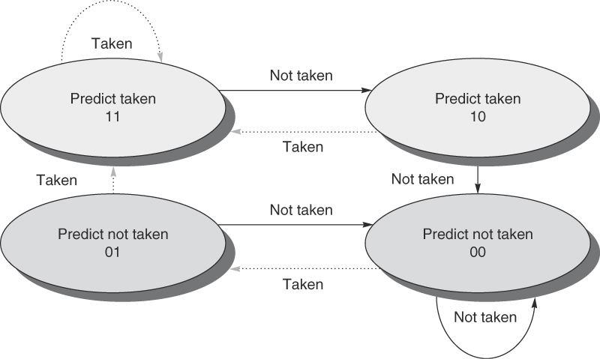
Control Hazards - Continued

Slide 17
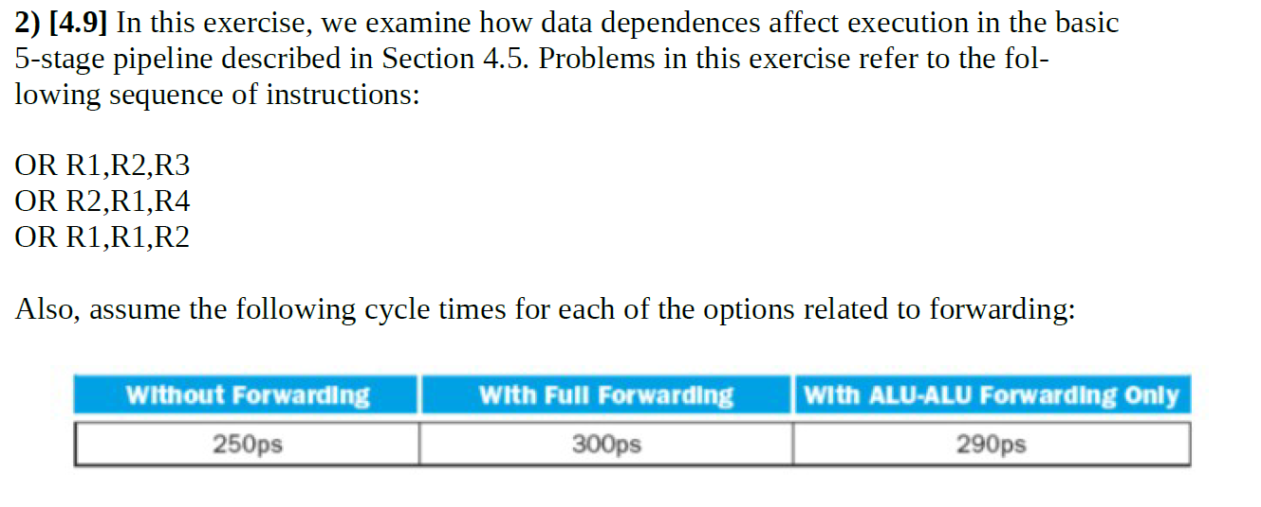
Sheet 2: Problem 2

Slide 18

Sheet 2: Problem 2 - Continued
OR R1,R2,R3
OR R2,R1,R4
OR R1,R1,R2
Raw R1, War R2
Raw R1, Waw R1
Raw R2, War R1

Slide 19
Sheet 2: Problem 2 - Continued
1
2
3
4
5
6
7
8
9
10
11
OR R1, R2, R3
F
D
E
M
W
NOP
F
D
E
M
W
NOP
F
D
E
M
W
OR
R2,R1,R4
F
D
E
M
W
NOP
F
D
E
M
W
NOP
F
D
E
M
W
OR R1,R1,R2
F
D
E
M
W
Total Cycles = 11

Slide 20

Sheet 2: Problem 2 - Continued
There are no hazards
ET with no forwarding = 11 * 250 = 2750ps
ET with full forwarding = (5 + 3 -1) * 300 = 2100 ps
Speed up = ET_{old} / Et_{new} = 2750/2100 = 1.309

Slide 21
Sheet 2: Problem 2 - Continued
1
2
3
4
5
6
7
8
9
OR R1, R2, R3
F
D
E
M
W
OR
R2,R1,R4
F
D
E
M
W
NOP
F
D
E
M
W
NOP
F
D
E
M
W
OR R1,R1,R2
F
D
E
M
W
Total Cycles = 9

Slide 22
Sheet 2: Problem 2 - Continued
ET with no forwarding = 2750ps
ET with ALU-ALU forwarding = 9* 290 = 2610 ps
Speed up = ET_{old} / Et_{new} = 2750/2610 = 1.05

Slide 23
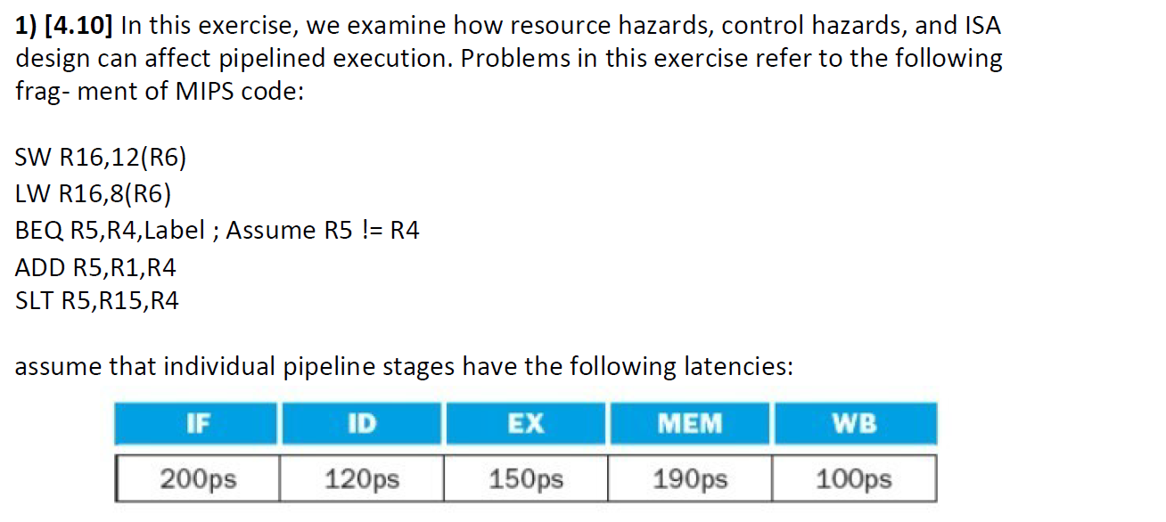
Sheet 3: Problem 1

Slide 24
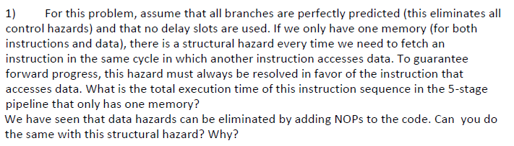
Sheet 3: Problem 1 - Continued
1
2
3
4
5
6
7
8
9
10
11
SW R16,12(R6)
F
D
E
M
W
LW R16,8(R6)
F
D
E
M
W
BEQ R5, R4, Label
F
D
E
M
W
ADD R5, R1, R4
bubble
bubble
F
D
E
M
W
SLT R5, R15, R4
F
D
E
M
W
Execution Time = 11 * 200 = 2200 ps
No, we cannot add NOPs as in NOPs we will still need to fetch

Slide 25
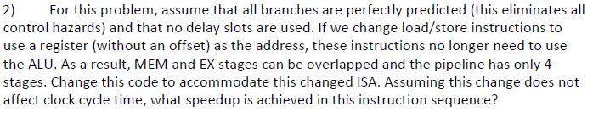
Sheet 3: Problem 1 - Continued
1
2
3
4
5
6
7
8
9
10
11
12
ADDI R6, R6, 12
F
D
E/M
W
SW R16,(R6)
F
D
E/M
W
SUBI
R6, R6, 4
F
D
E/M
W
LW R16,8(R6)
bubble
F
D
E/M
W
BEQ R5, R4, Label
F
D
E/M
W
ADD R5, R1, R4
bubble
F
D
E/M
W
SLT R5, R15, R4
F
D
E/M
W
Execution Time = 12 * 200 = 2400 ps
Speed up = 11/12 = 0.9167. This is actually a slow down!

Slide 26

Sheet 3: Problem 1 - Continued
Lets assume we have two memories.
When branch is calculated in Execute stage, the pipeline looks as follows
1
2
3
4
5
6
7
8
9
10
11
SW R16,12(R6)
F
D
E
M
W
LW R16,8(R6)
F
D
E
M
W
BEQ R5, R4, Label
F
D
E
M
W
ADD R5, R1, R4
stall
stall
F
D
E
M
W
SLT R5, R15, R4
F
D
E
M
W

Slide 27
Sheet 3: Problem 1 - Continued
Lets assume we have two memories.
When branch is calculated in Decode stage, the pipeline looks as follows
1
2
3
4
5
6
7
8
9
SW R16,12(R6)
F
D
E
M
W
LW R16,8(R6)
F
D
E
M
W
BEQ R5, R4, Label
F
D
E
M
W
ADD R5, R1, R4
stall
F
D
E
M
W
SLT R5, R15, R4
F
D
E
M
W
Given same clock , Speed up = 11/10 = 1.1

Slide 28
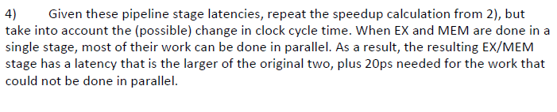
Sheet 3: Problem 1 - Continued
Now execute/mem stage takes 210 ps so clock is 210 ps instead of 200ps.
ET_{old} = 200 * 11 = 2200 ps
Et_{new} = 210 * 12 = 2520 ps
Speed up = 2200 / 2520 = 0.873 (Slow down)

Slide 29

Sheet 3: Problem 1 - Continued
ID stage latency is now 180 ps
Ex stage is now 140 ps
There is no change in clock, so same calculation

Slide 30
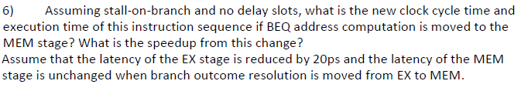
Sheet 3: Problem 1 - Continued
There will be 3 stall cycles instead of 2.
Total cycles are now 12.
Clock is not affected
So slow down = 11/12 = 0.9167

Slide 31
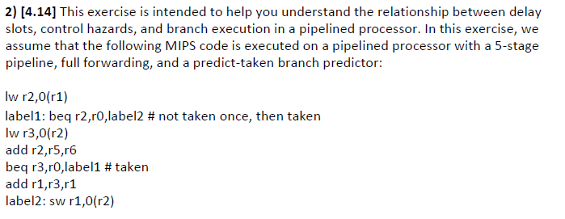
Sheet 3: Problem 2

Slide 32
Sheet 3: Problem 2 - Continued
1
2
3
4
5
6
7
8
9
10
11
12
Lw
r2,0(r1)
F
D
E
M
W
label1:beq
F
D
D
E
M
W
r2,r0,label2
--
load use stall (NT)
lw
r3,0(r2)
--
flush
F
F
label2: SW r1,0(r2)
F
--
flush
lw
r3,0(r2)
F
D
E
M
W
add r2,r5,r6
F
D
E
M
W
beq
r3,r0,label1 (T)
F
D
E
M
W
add r1,r3,r1
F
--
flush

Slide 33
Sheet 3: Problem 2 - Continued
10
11
12
13
14
15
16
label1:
beq
r2,r0,label2 (T)
F
D
E
M
W
lw
r3,0(r2)
F
--
flush
label2: SW r1,0(r2)
F
D
E
M
W

Slide 34
Sheet 3: Problem 2 - Continued
1
2
3
4
5
6
7
8
9
10
11
12
13
14
15
Lw
r
2,0
(r
1
)
F
D
E
M
W
label1:beq r2,r0,label2
F
D
D
E
M
W
--
load use stall (NT)
lw
r
3,0
(r
2
)
F
F
D
E
M
W
label2: SW r1,0(r2)
F
--
flush
add r
2
,r
5
,r
6
F
D
E
M
W
beq
r
3
,r
0
,label
1
(T)
F
D
E
M
W
add r
1
,r
3
,r
1
F
D
E
M
W
beq
r
2
,r
0
,label
2
(T)
F
D
E
M
W
lw
r
3,0
(r
2
)
F
D
E
M
W
label
2
: SW r
1,0
(r
2
)
F
D
E
M
W

Slide 35

Sheet 3: Problem 2 - Continued
We see in the first instruction that there is a load-use hazard (data hazard)
So the unit will need to detect data hazards.

Slide 36

Sheet 3: Problem 2 - Continued
1
2
3
4
5
6
7
8
9
10
11
12
13
14
15
16
Lw
r2,0(r1)
F
D
E
M
W
label1:beq r2,r0,label2
F
D
D
D
E
M
W
--
load use stall (NT)
lw
r3,0(r2)
F
F
F
D
E
M
W
add r2,r5,r6
F
D
E
M
W
beq
r3,r0,label1 (T)
F
D
D
E
M
W
add r1,r3,r1
F
--
flush
F
label1:
beq
r2,r0,label2 (T)
F
D
E
M
W
lw
r3,0(r2)
--
Flush
F
label2: SW r1,0(r2)
F
D
E
M
W
Speed up = 16/16 = 1

